Slide 1
Machine Learning
Week11

Slide 2
Introduction
Reinforcement learning can be considered the third genre of the machine learning:
Unsupervised learning,
clustering
Supervised learning
classification, regression
Reinforcement learning.
more general than supervised/unsupervised learning
learn from interaction agent and environment to achieve a
goal

Slide 3
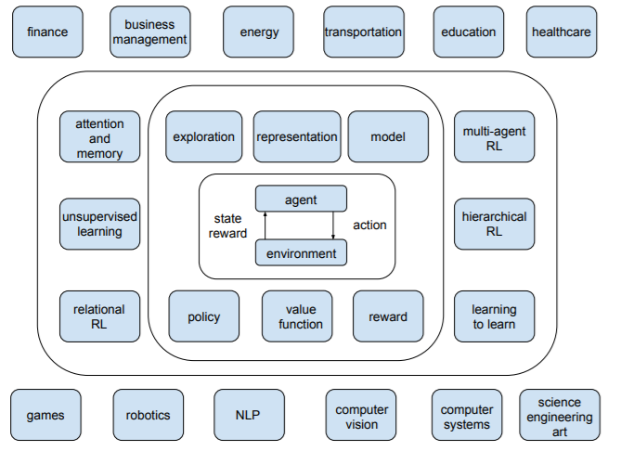
RL Application
Resources management in computer clusters
Traffic Light Control
Robotics
Web System Configuration
Chemistry
Personalized Recommendations
Bidding and Advertising
Games

Slide 4
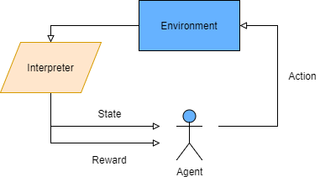
Learning Objective
In reinforcement learning, we create an agent which performs actions in an environment
The agent receives various rewards depending on what state it is in when it performs the action.

Slide 5
Terminologies and conventions
Agent:
This we create by programming such that it is able to sense the environment, perform actions, receive feedback, and try to maximize rewards.
Environment:
The world where the agent resides. It can be real or simulated.
State:
The perception or configuration of the environment that the agent senses. State spaces can be finite or infinite.
Rewards:
Feedback the agent receives after any action it has taken.
The goal of the agent is to maximize the overall reward, that is, the immediate and the future reward.

Slide 6
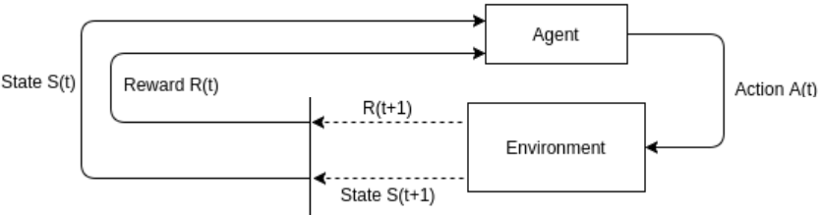
Terminologies and Conventions
Actions:
Anything that the agent is capable of doing in the given environment. Action space can be finite or infinite.
SAR triple:
(state, action, reward) is referred as the SAR triple, represented as (s, a, r).
Episode:
Represents one complete run of the whole task.
The way which the agent optimally learns is the subject of reinforcement learning theory and methodologies.

Slide 7
Markov Property
Given that the present state is known, the conditional probability of the next state is independent of the states prior to the present state.
Present state at time t is i: X_{t} = i
Next state at time t + 1 is j: X_{t+1} = j
All possible states for a system form a set called state space.
In Markov processes, we require this set of states to be finite.
Pr{X_{t+1} = j | X₀ = k₀, X₁ = k₁,…, X_{t} = i } = Pr{X_{t+1} = j | X_{t} = i }

Slide 8
Markov Process
As the system model complies with the Markov property, we can capture transition probabilities with a transition matrix, which is a square matrix of the size N×N, where N is the number of states in our model.
0
1
2
0
0.6
0.3
0.1
P =
1
0.8
0.2
0
2
1
0
0

Slide 9
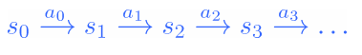
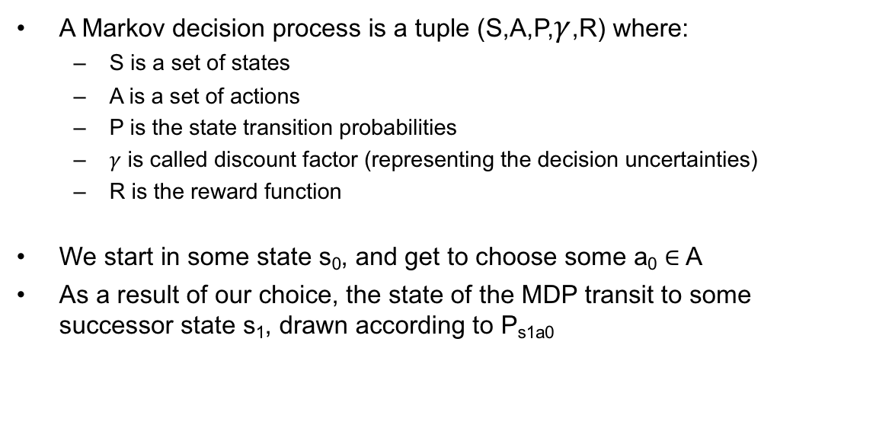
Markov Decision Process-summary
A Markov decision process is a tuple (S,A,P,$γ$,R) where:
S is a set of states
A is a set of actions
P is the state transition probabilities
$γ$ is called discount factor (representing the decision uncertainties)
R is the reward function
We start in some state s₀, and get to choose some a₀ ∈ A
As a result of our choice, the state of the MDP transit to some successor state s₁, drawn according to P_{s1a0}

Slide 10
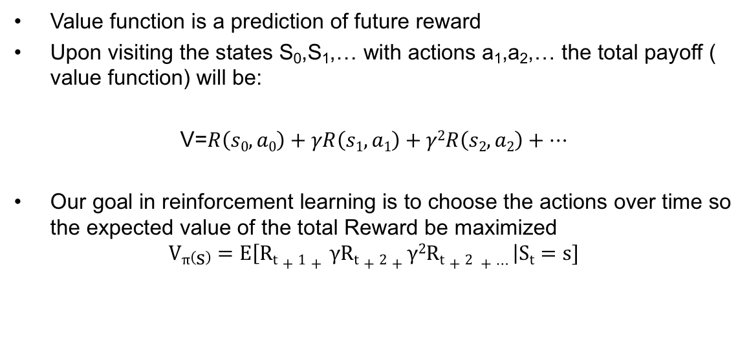
Value Function
Value function is a prediction of future reward
Upon visiting the states S₀,S₁,… with actions a₁,a₂,… the total payoff ( value function) will be:
V=$R\left(s0,a0\right)+γR\left(s1,a1\right)+γ2R\left(s2,a2\right)+…$
Our goal in reinforcement learning is to choose the actions over time so the expected value of the total Reward be maximized
$$Vπ\left(s\right)=E\left[Rt+1+ γRt+2+γ2Rt+2 +…\right|St=s]$$

Slide 11
Value Function
state value function: V^{π}(s)
expected return when starting in s and following π
state-action value function: Q^{π}(s,a)
expected return when starting in s, performing a, and following π
useful for finding the optimal policy:
can estimate from experience
pick the best action using Q^{π}(s,a)

Slide 12
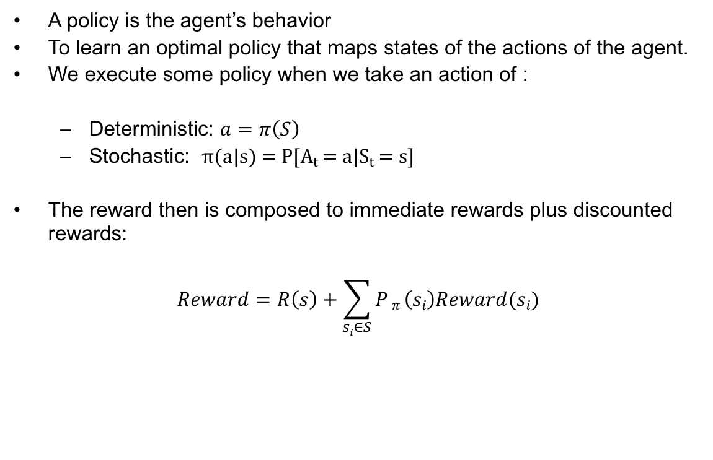
The Policy
A policy is the agent’s behavior
To learn an optimal policy that maps states of the actions of the agent.
We execute some policy when we take an action of :
Deterministic: $a=π\left(S\right)$
Stochastic: π(a|s) = P[A_{t} = a|S_{t} = s]
The reward then is composed to immediate rewards plus discounted rewards:
$$Reward=R\left(s\right)+\sum_{si∈S}{P}π \left(si\right)Reward(si)$$

Slide 13
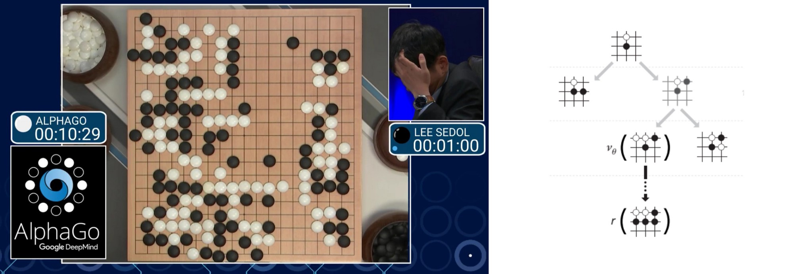
The Model
A model predicts what the environment will do next
P predicts the next state
R predicts the next (immediate) reward, e.g.

Slide 14
Constraints
The outcome of your actions may be uncertain
The reward may be delayed and/or stochastic.
No clear model about how the world responds to actions.
The environment may change while trying to learn it
Elapsed time to explore uncharted territory before exploiting what you have learned?

Slide 15
Learning methodologies
Policy based:
Directly search and learn a policy function (maximum future reward)
Learn the stochastic policy function that maps the state to the action
Value based models:
Learn the state or state-action value
Estimate the optimal value function Q*(s,a) (i.e. maximum value achievable under any policy)
Act by choosing the best action in the state.
Model-based: build a model of the environment
Dynamic programming (memory intensive)
Upgrade model and re-plan often
Example: chess
Extremely efficient

Slide 16
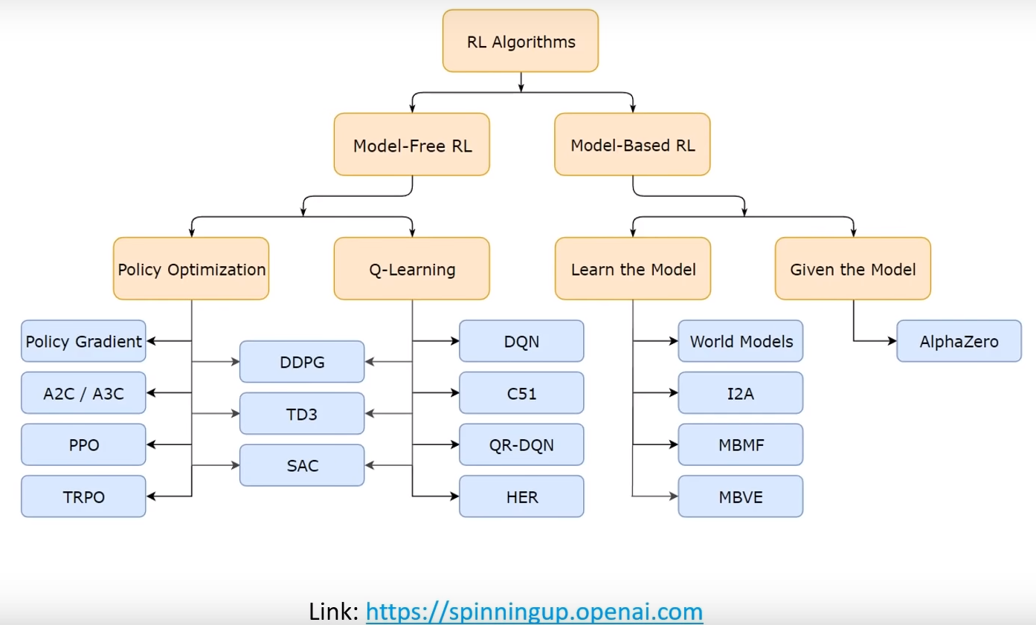
Model Free and Model Based RL

Slide 17
Reinforcement Learning
Mont Carlo :
MC we play a whole episode until the end then we compute the discounted reward for each state that appeared in the episode.
Temporal difference learning:
In DP we randomly initialize all the states, and then we iteratively compute the value of each state based on the (previously computed) values of the surrounding states.. TD will be noted as TD(0) which means it will look ahead one step. TD(0) is particular case of TD(n)

Slide 18
Temporal difference learning
TD learning algorithms are based on reducing the differences between estimates made by the agent at different times.
The basic idea of Q-Learning is to approximate the state-action pairs Q-function from the samples of Q(s, a) that we observe during interaction with the environment. This approach is known as Time-Difference Learning.
The most used TD learning algorithms are the following:
SARSA:
SARSA is an On-Policy method, which means it computes the Q- value according to a certain policy and then the agent follows that policy.
Q-learning:
Q-Learning is an Off-Policy method. It consists of computing the Q-value according to a greedy policy, but the agent does not necessarily follow the greedy policy.
Deep Q-learning

Slide 19
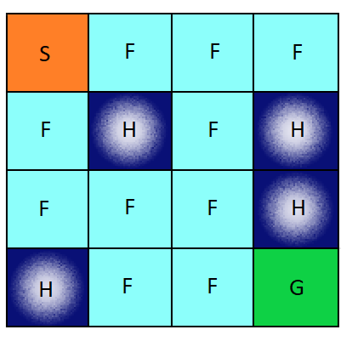
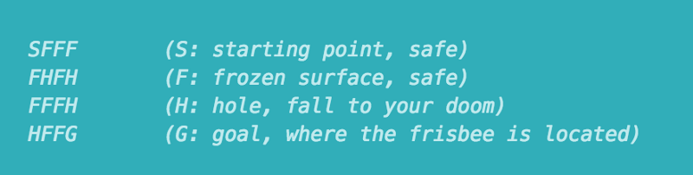
Q-learning
Tabular Approaches for Tabular Environments
e.g. The rules of the FrozenLake environment

Slide 20
Learning Objective
The FrozenLake environment consists of a 4x4 grid of blocks,
each one either being the start block, the goal block, a safe frozen block, or a dangerous hole.
The objective is to have an agent learn to navigate from the start to the goal without moving onto a hole.
The reward at every step is 0, except for entering the goal, which provides a reward of 1 and -1 for falling in hole.

Slide 21
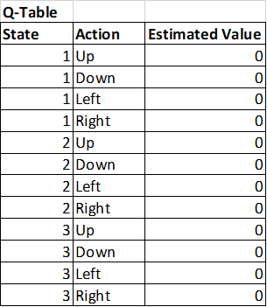
Learning Objective
Q-Learning is a table of values for every state
(row) and action (column) possible in the
environment. Within each cell of the table,
we learn a value for how good it is to take a
given action within a given state.
we have 16 possible states (one for each block)
, and 4 possible actions (the four directions of
movement), giving us a 16x4 table of Q-values.
We start by initializing the table to be uniform
(all zeros), and then as we observe the rewards
we obtain for various actions, we update the table accordingly.

Slide 22
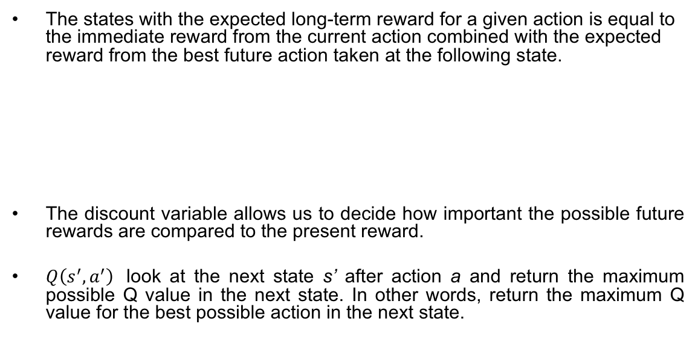
Bellman equation
The states with the expected long-term reward for a given action is equal to the immediate reward from the current action combined with the expected reward from the best future action taken at the following state.
The discount variable allows us to decide how important the possible future rewards are compared to the present reward.
$Q\left(s^{′},a^{′}\right)$ look at the next state s’ after action a and return the maximum possible Q value in the next state. In other words, return the maximum Q value for the best possible action in the next state.

Slide 23
Q learning with ϵ-greedy action selection
So we need a way for the agent to eventually always choose the “best” set of actions in the environment, yet at the same time allowing the agent to not get “locked in” and giving it some space to explore alternatives.
Solution: The ϵ-greedy policy.
There is a value ϵ (which may be set to decay over time) where, if a random number is selected which is less than this value, an action is chosen completely at random. This step allows some random exploration of the value of various actions in various states, and can be scaled back over time to allow the algorithm to concentrate more on exploiting the best strategies that it has found.

Slide 24
Q-Learning with neural network
Tables don’t really scale.
the number of possible states in any modern game or real-world environment is nearly infinitely larger
We instead need some way to take a description of our state, and produce Q-values for actions without a table
Solution: neural networks

Slide 25
Deep Q-learning technique
How can we make Deep learning and Q learning work together?
All we need to know is how to make differentiable models.
Using gradient method we have
Deep Q network input the state and output is different action. It means instead of
x=feature_expansion(s,a) replace by x=feature_expansion(s)
Each output nodes correspond to different action.

Slide 26
Q-Learning with neural network
best_action = arg max(NN predicted Q-values ).

Slide 27
Deep Q-learning

Slide 28
Experience replay
(s,a,r,s’) triples to train with all at once at the end of an episode.
Generate the replay buffer. Buffer is a queue, FIFO (First in-First out)
Sample a random mini-batch from the buffer
apply gradient descent on the sample.
Size of the buffer is a hyper parameter

Slide 29
Exploration-exploitation dilemma
Decision-making involves a fundamental choice:
Exploitation: Make the best decision, given current information
Exploration: Collect more information
A good solution to the problem is to find a balance between exploration and exploitation:
Too much exploring will act in a casual way in every state (convergence issue)
If an agent explores little, it will always use the usual actions, which may not be optimal ones

Slide 30
Semi-Gradient
Q approximation is used itself as the target for error calculation.
Therefore the gradient is not true gradient and is called semi-gradient.
This property leads instability in deep Q-learning
Solution: Use another deep Q-network for estimation the target.
Target network is a copy
of Q network but not updated
as Q-network

Slide 31
CNN Deep-Q learning
State is raw pixels from the screen
This is more flexible than position + velocity
Here we apply convolutional neural network.
The limitation of used Markov model is that it tries to predict using the last current state. Here we use higher order of Markov model and we use several images in the row for better prediction of next one.

Slide 32
CNN Deep-Q learning
State(t)=[image(t-3), image(t-2), image(t-1), image(t)]
Stack four frames: (4,H,W,C)
Convert to grayscale (4,H,W)
The 3-dimention state will be easy input the convolutional neural network.

Slide 33
Preprocessing
Preprocessing is an important step. We want to reduce the complexity of our states to reduce the computation time needed for training.

Slide 34
CNN Deep-Q learning-flowchart
Deep neural network to approximate Q(s,a) with output node
Experience replay: Train from a buffer of (s,a,s’,a’)
Target network
CNN with 4 past frame as the state.

Slide 35
Preprocessing
This simple neural network will receive the entire image and output the probability of action.

Slide 36
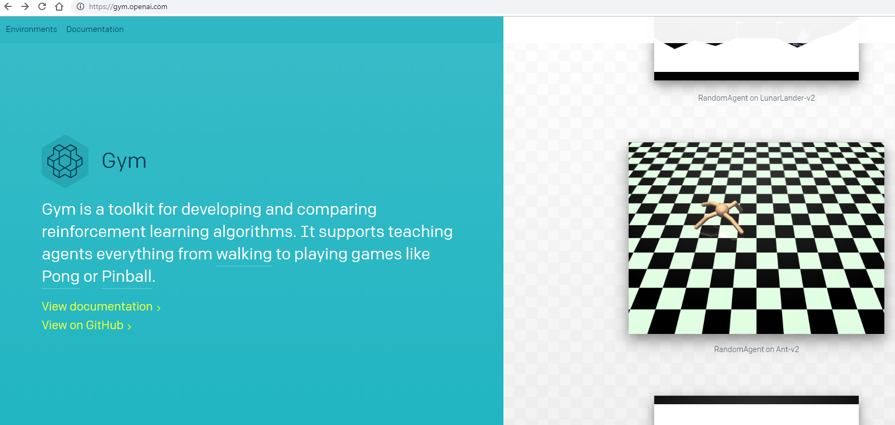
Open AI Gym
Gym is a toolkit for developing and comparing reinforcement learning algorithms. It makes no assumptions about the structure of your agent, and is compatible with any numerical computation library, such as TensorFlow or Theano.
https://gym.openai.com/

Slide 37
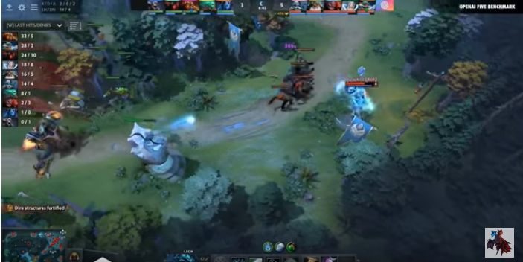
Open AI Gym
https://www.youtube.com/watch?v=eaBYhLttETw
https://openai.com/five/

Slide 38
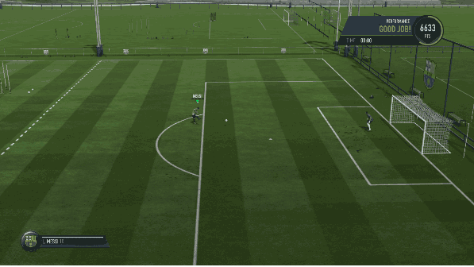
Reinforcement Learning with FIFA by (Chintan Trivedi)
https://towardsdatascience.com/using-deep-q-learning-in-fifa-18-to-perfect-the-art-of-free-kicks-f2e4e979ee66?gi=b96ce845729c
Lezwon Castellino:
https://becominghuman.ai/reinforcement-learning-with-fifa-and-keras-85ec792e25b2

Slide 39
Reinforcement Learning with FIFA
States: Screenshot images of the game processed through a MobileNet CNN giving 128-dimensional flattened feature map.
Actions: Four possible actions to take shoot_low, shoot_high, move_left, move_right.
Reward: If upon pressing shoot, in-game score increases by more than 200, we scored a goal so r=+1. If we missed the goal, score remains the same so r=-1. Finally, r=0 for actions related to moving left or right.
Policy: Two-layered Dense Network that takes feature map as input and predicts total final reward for all 4 actions.

Slide 40
Reinforcement Learning with FIFA

Slide 41
Reinforcement in trading
https://quantdare.com/deep-reinforcement-trading/
The model is applied on Tesla Inc. stock. Training period ranges from 2012-11-25 to 2017-11-25, with 200 episodes with a price window of 10 days.

